Slide 1
Consumer Goods Analytics Using MySQL and Microsoft EXCEL
Presented By: Vinish Kamble

Slide 2
INTRODUCTION
AtliQ Hardware (fictitious corporation) is one of the top Computer Hardware Manufacturer in India and Beyond.
The management has identified a need for more insights on Company products sale to make data-informed decisions.

Slide 3
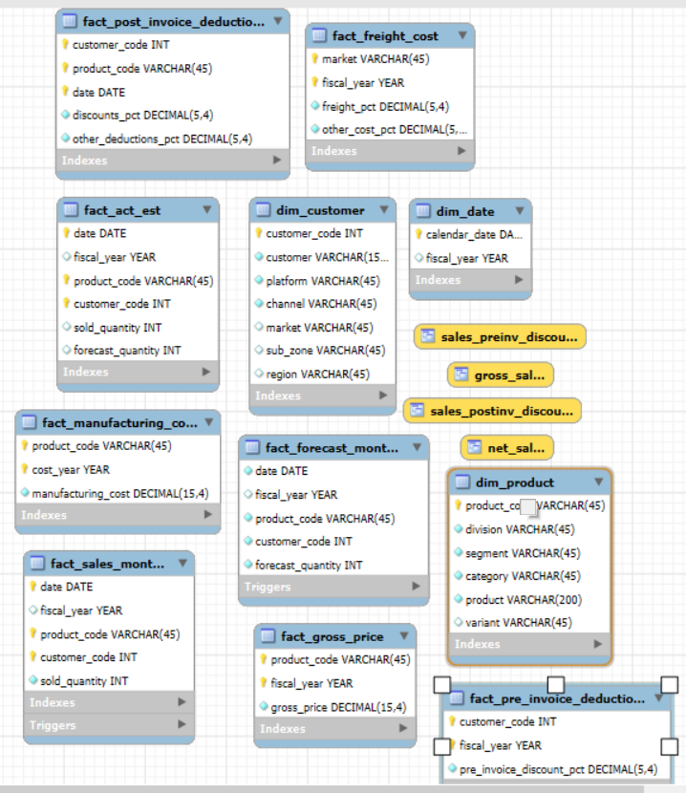
DATABASE SCHEMA

Slide 4
Database schema descriPtion
Fact Tables
gdb0041.fact_forecast_monthly:
Contains monthly sales forecast data.
Key Metrics: Forecasted sales quantities and values.
Granularity: Monthly.
gdb0041.fact_act_est:
Stores actual sales and estimated data.
Key Metrics: Sold quantities, sales values, and estimates.
Granularity: Varies based on actual vs. estimated data.

Slide 5
gdb0041.fact_freight_cost:
Records freight costs associated with sales.
Key Metrics: Freight cost amounts.
Granularity: Transactional.
gdb0041.fact_gross_price:
Tracks gross sales prices before any deductions.
Key Metrics: Gross sales amounts.
Granularity: Transactional.
gdb0041.fact_manufacturing_cost:
Contains manufacturing cost details for products.
Key Metrics: Manufacturing cost amounts.
Granularity: Transactional.

Slide 6
gdb0041.fact_post_invoice_deductions:
Stores deductions applied after invoicing.
Key Metrics: Post-invoice deduction amounts.
Granularity: Transactional.
gdb0041.fact_pre_invoice_deductions:
Records deductions applied before invoicing.
Key Metrics: Pre-invoice deduction amounts.
Granularity: Transactional.
gdb0041.fact_sales_monthly:
Contains actual monthly sales data.
Key Metrics: Sold quantities and sales values.
Granularity: Monthly.

Slide 7
Dimension Tables
gdb0041.dim_customer:
Provides details about customers.
Key Attributes: Customer ID, name, market, region, and other demographic information.
gdb0041.dim_date:
Contains date-related information to support time-based analyses.
Key Attributes: Date, year, quarter, month, day of the week, and other calendar details.
gdb0041.dim_product:
Stores product-related details.
Key Attributes: Product ID, name, category, division, and other product characteristics.

Slide 8

HIGHLIGHTS
User-Defined Functions:
Created custom functions to encapsulate reusable logic, enhancing query efficiency and maintainability.

Slide 9
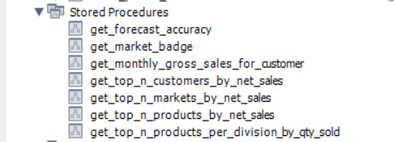

Stored Procedures:
Developed stored procedures to automate complex data processing tasks, ensuring consistency and reducing manual effort.
Views:
Implemented views to provide simplified and secure data access, improving the overall data management and reporting capabilities.
Advanced SQL Features:
Utilized advanced SQL features such as Common Table Expressions (CTEs), Window Functions to optimize query performance and data retrieval.

Slide 10
Key Achievements
Data Aggregation:
Successfully aggregated sales data across multiple dimensions, providing insights into market trends and product performance.
Real-Time Reporting:
Enabled real-time reporting through dynamic SQL queries, facilitating timely decision-making for business stakeholders.

Slide 11
Impact
Enhanced Data Visibility:
Improved data visibility and accessibility for end-users, empowering them to make data-driven decisions.
Operational Efficiency:
Streamlined data processing workflows, significantly reducing the time required to generate analytical reports.
Scalable Solutions:
Designed scalable solutions capable of handling large datasets, ensuring the system remains responsive as data volumes grow.

